Slide 1

Kofax RPA 11.2
Sales and Partners Enablement (July 28, 2021)
David Wright
Enablement Program Manager RPA and Transformation, Kofax

Slide 2


Agenda
Omid Aslani
Director, Commercial Product Management Intelligent Automation Portfolio
Market Update and Challenges
Solution Overview
What’s New in this Release
Competitive Landscape
How we Differentiate
Summary and Q&A
Jesper Scherpenhuijsen
Consultant Sales Engineer
Notes:
Welcome everyone.
I am please to share with you the key features and capabilities in RPA 11.2.
I have a few colleagues helping me out today.
Jesper will provide a great demo on the capabilities that I will discuss here shortly.
While David Wright will help answer your questions. So, please don’t be shy and use the chat feature to ask your questions.
We have setup extra time at the end also for more Q/A. In the past, we ended early, and we want to improve on that to answer your questions and enable you to go sell RPA and other Intelligent Automation portfolio capabilities.
Today, we will provide ample time and we will finish when we are done with the questions. Thanks to David and other Kofax SMEs who are here helping.

Slide 3
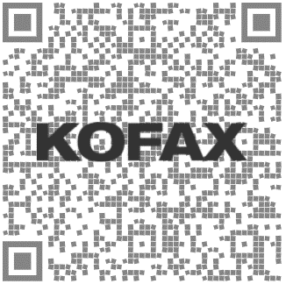

Our Customers Absolutely Love Kofax RPA
Market Update and Challenges
Kofax RPA enables University Hospitals clinical staff to focus on patient care vs. transactions
Kofax RPA provides Rabobank citizen developers capabilities to drive business value
Kofax RPA helps Duke Energy reimagine business rules and improve customer experience
Processed over 57,000 transactions through automation allowing nurses to be nurses instead of data entry clerks. RPA works overnight so when clinicians arrive in the morning, they face 20 transactions vs. 600 daily.
As of Feb 2020, drove 1,900,000 hours in business value. 2021 sees a new record in accelerating speed of innovation and automation. Enabling citizen developers through low-code RPA platform.
Contact center in conjunction with robots managed over 3,000,000 calls and established over 500,000 payment plans with a 99% reliability and availability rate. NPS soared over 50 for the entire year of 2020.
Notes:
It’s time to talk about the Kofax RPA.
We’ve been working diligently to continuously create value for our customers by automating manual tasks in their workflows.
With our no-code solution, we enable and empower thousands of citizen developers and analysts to:
Drive faster process improvements
Collaborate with business analysts, SMEs, and professional developers on solutions
Iterate on solution rapidly and generate great ROIs
Our customers love Kofax RPA!!! and have been driving amazing outcomes taking out thousands of non-value-added work hours, enabling their employees to utilize their intelligence vs. performing mundane tasks, and have dramatically improved their customer experience and NPS scores.
The Kofax Customer Excellence Awards Program was a testament of some of their achievements, and we are so very proud of what they have accomplished in their organizations.

Slide 4
2021 RPA Trends & Predictions
Market Update and Challenges
Strategic competitive RPA strategies
Half of all new RPA clients will come from business buyers who are outside the IT organization (Gartner)
Through 2024, organizations will triple the capacity of their existing IA portfolios (Gartner)
“Future” state
Increase RPA use among business users
90% of organizations globally will have adopted RPA (Gartner)
2021 Expected global RPA revenue >$2B
Up 20% from 2020
Hyperautomation is set to become widely used across enterprises
Tactical response to COVID-19
RPA demand continues to grow to support critical processes through resilience and scalability
“Today” state
Notes:
According to a September 2020 Gartner, Inc. report, global RPA software revenue was projected to reach $1.9 billion in 2021, with a 19.5% increase from yea prior.
This projection from last year is now grown in the face of the economic instability caused by COVID-19.
What’s more is that the global RPA market share is forecasted to continue to grow by double digits through to 2024.
The recession as a result of the pandemic is forcing companies to look to automation to improve overall operational efficiency while reducing costs.
And to achieve some quick results, the answer and solution has been RPA. And we are excited to have one of the leading RPA solutions and to continue to invest in our product to meet the market demand.
But that’s not where Kofax stops!
As powerful and simple as RPA is to utilize, there is a greater need for what we call Intelligent Automation and Gartner for instance refers to as Hyperautomation.
As company executives look to drive out costs through end-to-end DWT, improve employee morale and customer experience and maintain their competitive edge, they need a platform to go beyond RPA.
To capture information, to transform and interpret data, to orchestrate work amongst RPA and human workforce, and integrate to various services or platforms. That’s what is needed today to drive true automation.

Slide 5



Key Market Findings
Market Update and Challenges
The pandemic has raised the urgency for organizations to digitally transform their processes. Requiring capabilities far beyond RPA. RPA requires structured digital data to operate thus the need for Intelligent Automation.
Many vendors are entering the RPA space, while some large vendors are disrupting the RPA stand-alone software opportunity.
Buyers are from a diverse vertical markets. Adoption is driven by North America, Europe and in large to midsize enterprises.
Intelligent Automation

Slide 6
High Demand From Large and Midsize Enterprises
Market Update and Challenges
Demand driven by line-of-business executives
Desire to reduce costs and connect legacy applications
Executives are ﬁnding it increasingly difﬁcult to understand why they need to wait for IT to integrate their existing technology solutions
COVID-19 highlighted the challenge of paper based and manual processes
Buyers frustrated look to their existing RPA providers to facilitate the supply of the wider Intelligent Automation capabilities
19,000 Paying Customers
“
The RPA software market grew 38.9% in 2020 to $1.9B and held its position as the fastest-growing segment in the enterprise software market. - Gartner
2019
9,000 Paying Customers
2018
Gartner: Market Trends: RPA Morphing Into Hyperautomation - Published 11 September 2020 - ID G00717133

Slide 7
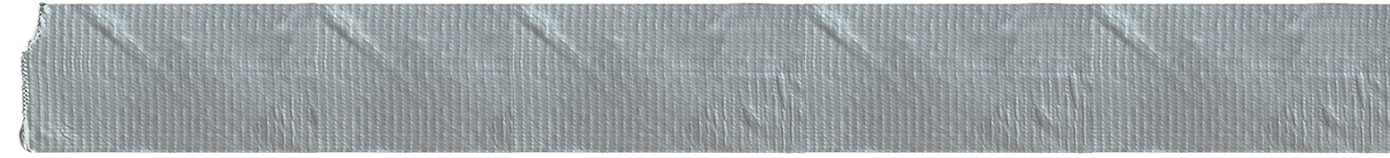
Top Challenges With Many RPA Only Vendors and Solutions
Market Update and Challenges
No ability to read and interpret unstructured (image or graphic) data
Dependencies on UI (changes to application/web page layouts can break robots)
Typically, a ‘band-aid’ fix to a broken underlying process (solves immediate pain v. overall workflow)
Additional IT costs for system OS and dedicated workstations for robots (end user desktop, VM)
New pricing models from new entrants are incredibly inexpensive, making RPA as a stand-alone sell look increasingly less proﬁtable
Hard to maintain/scale beyond proof of concept without added complexity and overhead
Only a point solution that cannot easily solve larger workflow automation goals requiring additional capabilities
If it can’t be fixed with duct tape, you’re not using enough!

Slide 8
Intelligent Automation Remains a Key Driver
Market Update and Challenges
“
RPA buyers are striving toward an orchestrated, end-to-end, intelligent, event-driven form of automation, delivered with an effective combination of automation tools with multiple machine learning applications and packaged software. Gartner calls this “hyperautomation.”
RPA is just one subset of the key technologies used to support hyperautomation.
- Gartner
Gartner: Market Share Analysis: Robotic Process Automation, Worldwide, 2020 - Published 26 May 2021 - ID G00746550
Notes:
Read the quote highlights
Intelligent Automation combines the rules-based automation capabilities of RPA with the sophistication of Artificial Intelligence, combined with Machine Learning to enable fundamental digital workflow transformation.
This has a revolutionizing effect on business efficiency and strategy as a smarter, faster, and more sophisticated Intelligent Automation is set to become widely used across large-scale enterprises.
Harnessing the power of AI, RPA, and Machine Learning (ML), Orchestration and Integration capabilities, Kofax’s Intelligent Automation portfolio is designed to process massive volumes of data end-to-end seamlessly to optimize business processes across multiple and diverse areas.
As automation will be adopted at much higher volumes in the coming years, the need to automate more complex tasks will become more apparent and that’s how our Kofax’s strategy to invest on IA platform will continue to drive high value for our customers and partners.

Slide 9
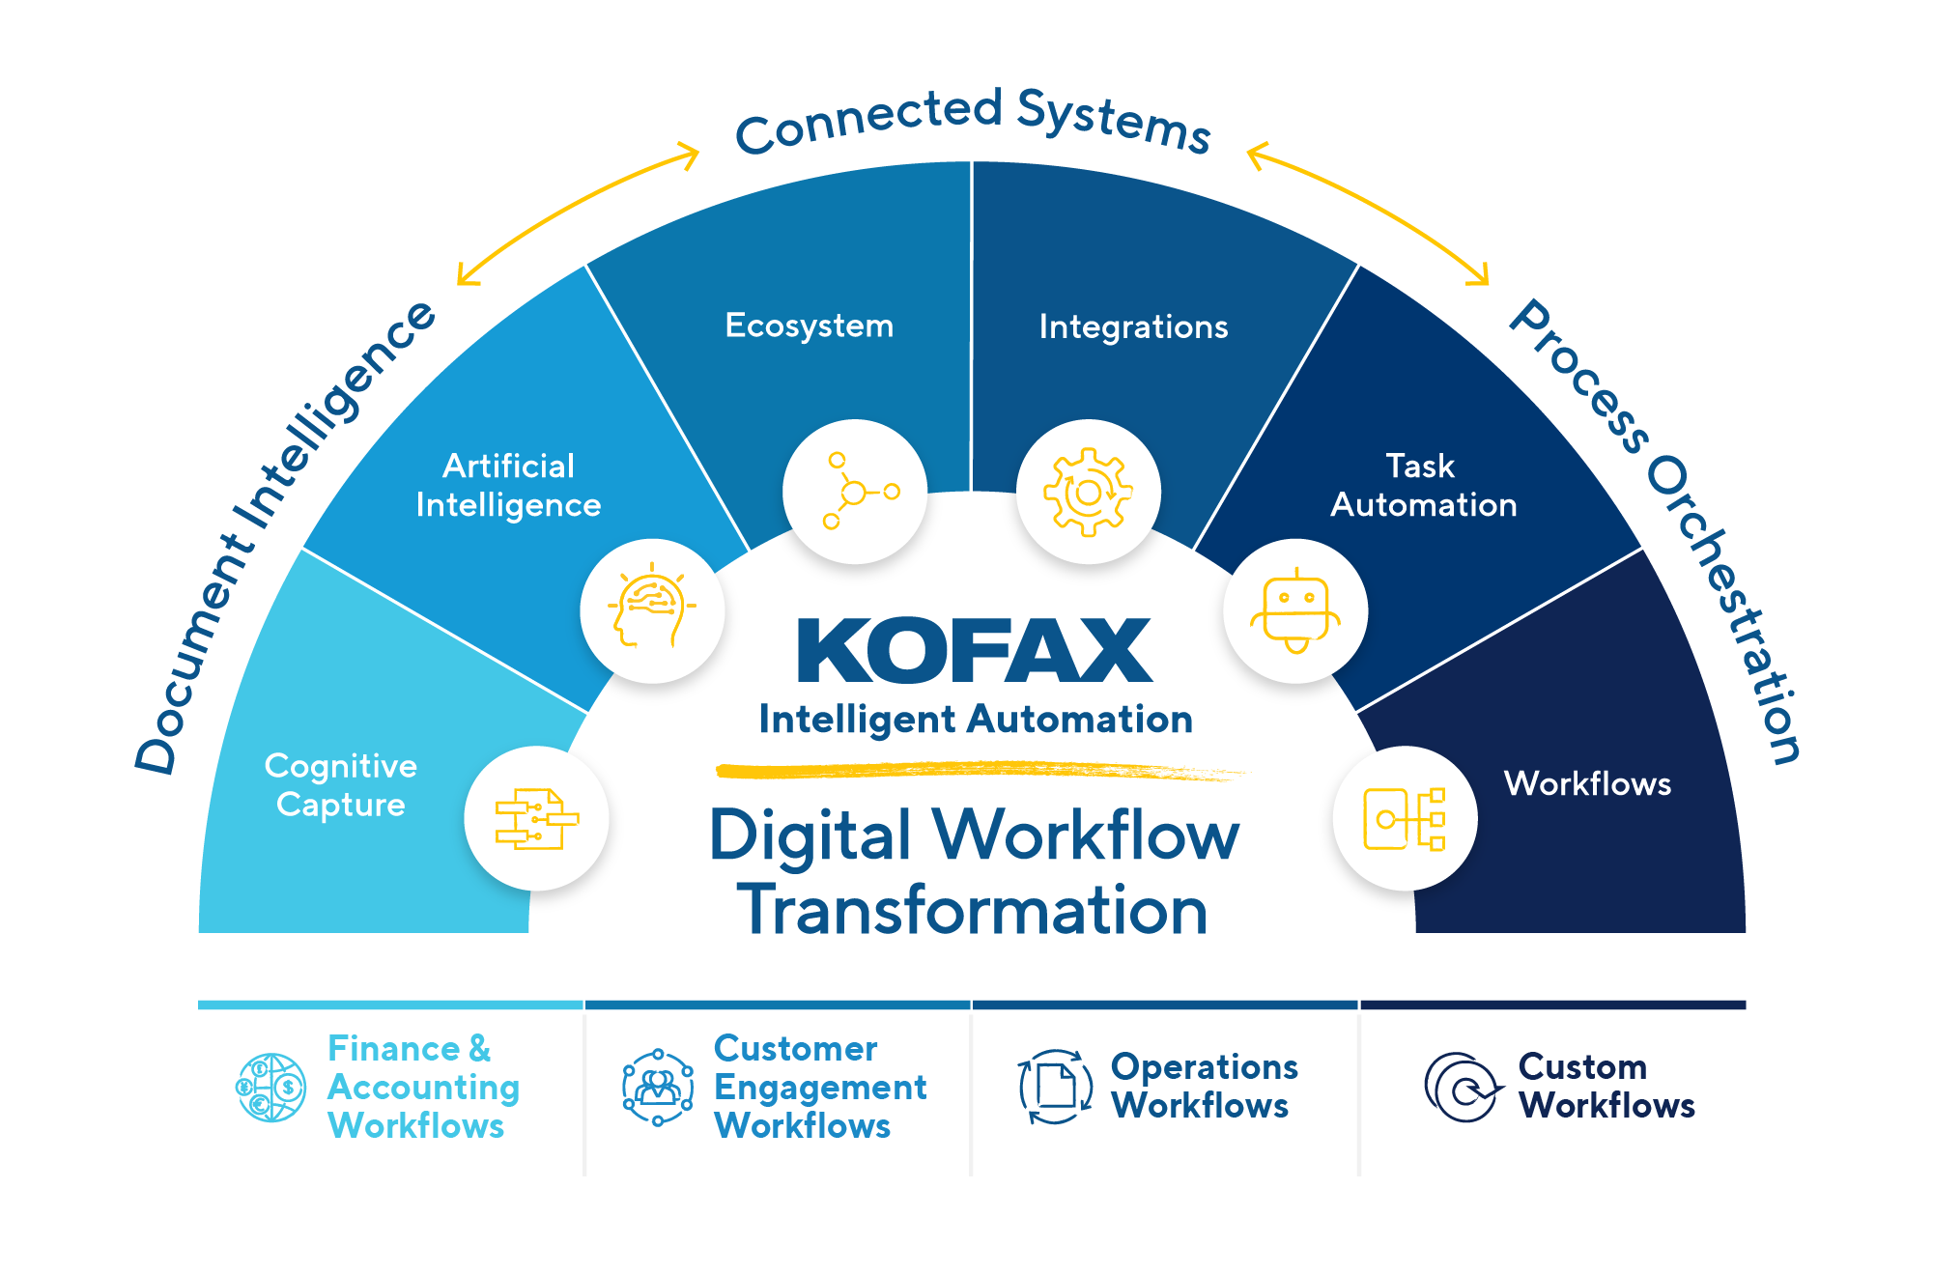
Intelligent Automation Platform
Solution Overview

Slide 10
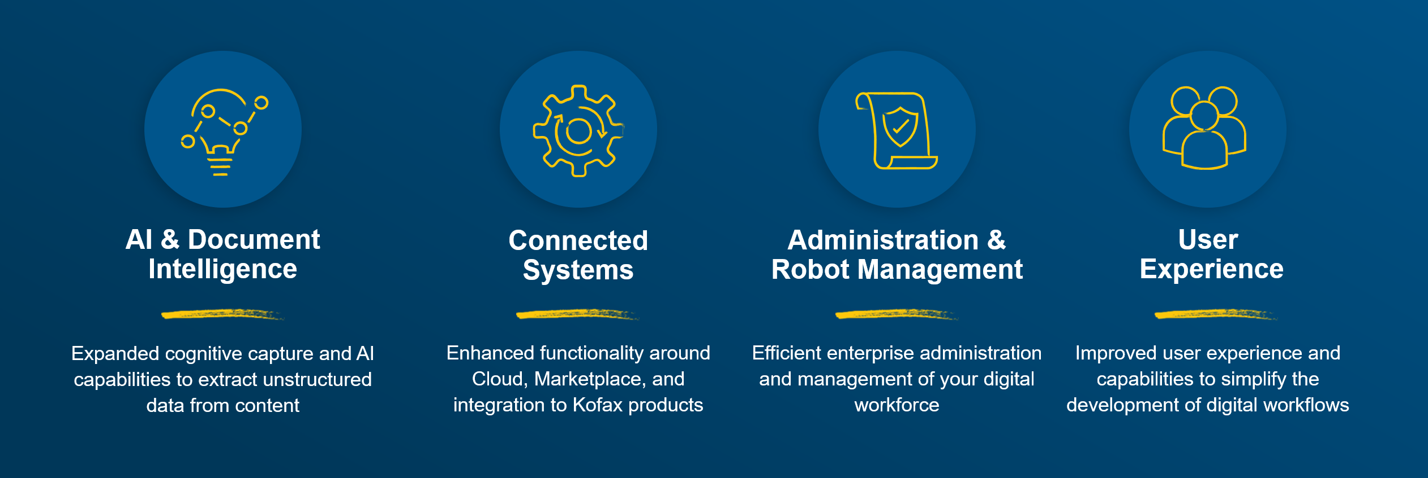




Continued RPA Key Investment Areas
Solution Overview
Advanced support for security, compliance, scale, audit, and cloud
Developer Tools
Simplified development of robots and maintenance, tools and debugging
Kofax Robotic Process Orchestration (RPA)
AI & Cognitive Capture
Developers
Tools
Administration & Robot Management
Integrated
Platform
Expanded cognitive capture and AI capabilities for enhanced document, data, vision, and process understanding.
Improved user experience and capabilities to simply and speed the development of web and desktop automation
Enhanced enterprise administration and management of your digital workforce.
Accelerated platform functionality around Cloud, marketplace, and partner ecosystem, and simplified access to the Intelligent Automation Platform
Notes:
Enterprise Management
Scale out / on-demand architecture
Password Management Support – CyberArk
Process visualization (11.0)
Capabilities for more quickly identifying and defining automatable processes
Artificial Intelligence
Integrated OCR and machine learning technology
Extensible robot architecture ready to connect to next generation micro apps and services
User Experience
Refresh of UX/UI MC ability to initiate robots from mobile devices
Design Studio improvements with Docable Windows.
Partner Ecosystem
Extensible robot architecture ready to connect to next generation micro apps and services
Developer Tools
Robot Management
Kapplets revised Enterprise readiness
Intelligent Automation Platform
Tighter integration with applications such as KTA, Document Transformation, etc.

Slide 11



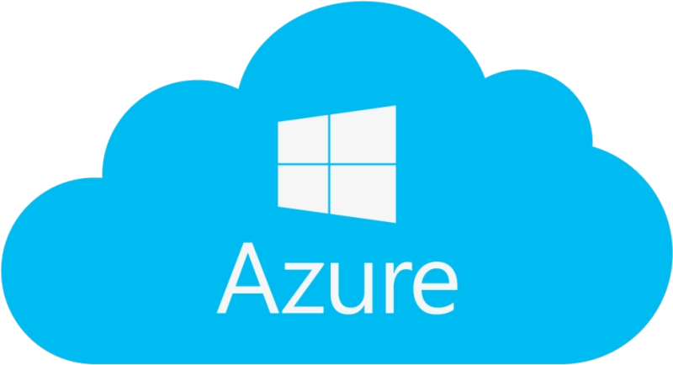





Deployment Options
Solution Overview
On-Premise
Customer Cloud
See Technical Specification Document for details, but some components are only supported on Windows
A Kofax hosted SaaS offering of Kofax RPA is not available
Notes:
Simplified deployment, scaling and management using Kubernetes and docker.

Slide 12
Purchasing Options
Solution Overview
License Components | Concurrent Robot Execution (CRE) | Design Studio | KappZone | High Availability | Cognitive Document Automation (CDA) | Kofax Process Intelligence (KPI) | Time Limitation
License Behaviour | # of robots that can be executed on RoboServers at a time | # of Design Studio seats connected to Management Console | # of seats that can execute Kapplets at a time | Activation of high availability | # of pages that can be processed annually with Document Transformation Services (DTS) | # of application sources and # of users | Sets the expiry date for a license
Kofax RPA term production license | Base package comes with: - 1 production CRE - unlimited non-production CREs Additional CREs can be added. | Unlimited | Unlimited | Included | Included with 10,000 pages | Included with 2 concurrent users, Kofax Analytics for RPA and Process Discovery dashboards and Kofax app sources only. Can be expanded with regular KPI parts | Limited to the number of signed up years. Can be renewed every year.
Kofax RPA perpetual production license |  |  |  |  |  |  | Unlimited, no expiration date
Kofax RPA evaluation license | - no production CRE - 4 non-production CREs | 2 Design Studio seats | Unlimited | Not included | Included with 10,000 pages | Included with 2 concurrent users, Kofax Analytics for RPA and Process Discovery and Kofax app sources only. | Requires management approval, typically 90 days
Kofax RPA Free Trial | - no production CRE - 1 non-production CREs | 1 Design Studio seat | Unlimited | Not included | Included with 10,000 pages | Not included | Limited to 3 months (and limited support only)

Slide 13
Purchasing Options
Solution Overview
Term
Perpetual
Base package
KP-RPA-BA01-TERM Kofax RPA (1 PR) - Term on Prem
KP-RPA-BA01 Kofax RPA (1 PR)
Additional robots
KP-RPA-PR01-TERM Additional Production Robot(s) - Term
on Prem
KP-RPA-PR01 Additional Production Robot(s)
Concurrent Robot Executions (CRE): # of robots that can be executed on RoboServers at a time
Example: 8 concurrent robots
Description | Part# | Qty | Price
Kofax RPA (1 PR) - Term on Prem | KP-RPA-BA01-TERM | 1 | $ 12,317.00
Additional Production Robot(s) - Term on Prem | KP-RPA-PR01-TERM | 7 | $ 68,031.00
 | TOTAL |  | $ 80,348.00
Description | Part# | Qty | Price
Kofax RPA (1 PR) | KP-RPA-BA01 | 1 | $ 17,850.00
Additional Production Robot(s) | KP-RPA-PR01 | 7 | $ 98,595.00
Kofax RPA Standard Support 1 YR | MC-2000-0110 | 20% | $ 23,289.00
 | TOTAL |  | $ 139,734.00
See GPL
See GPL

Slide 14
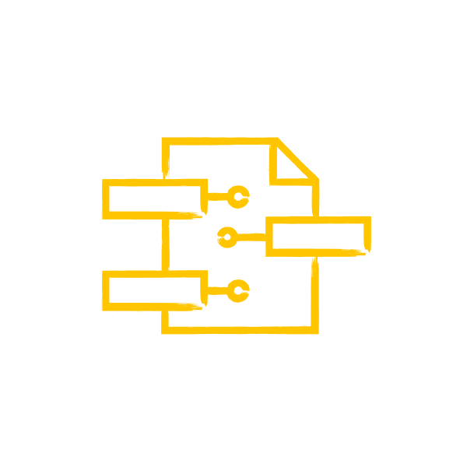

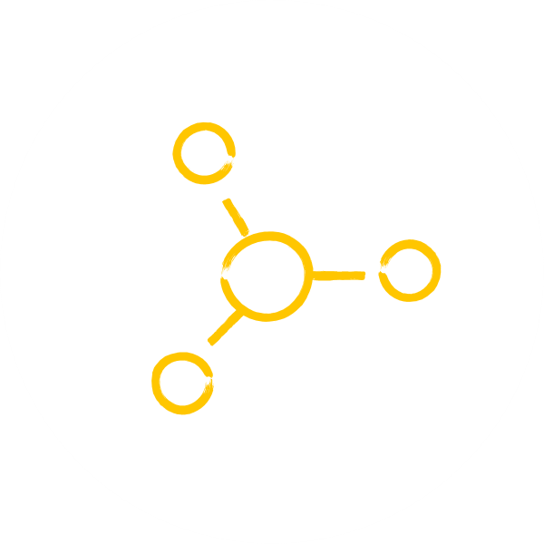


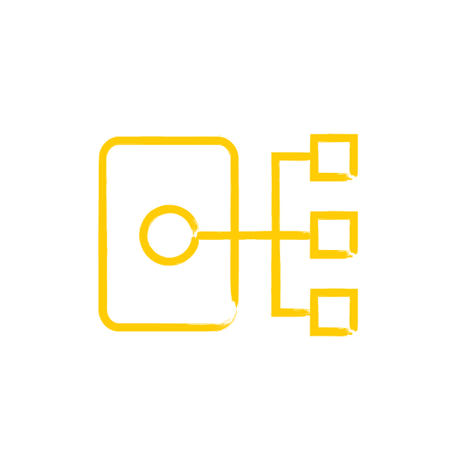

Kofax RPA 11.2 – Release Highlights
Release Positioning
Document Intelligence
Connected Systems
Process Orchestration
Cognitive Capture
Artificial Intelligence
Ecosystem
Integrations
Task Automation
Workflows
Cloud AI Service Consumption
Incorporated Google Cloud, Amazon Web Services, and Microsoft Azure as AI service provider for image/text analysis
License Utilization Monitoring
Transparency and reporting of license utilization to improve TCO
SignDoc Integration
New SignDoc Step to assign information and kick-off signing ceremonies. Supporting IA strategy
Enhanced Robot Management
Get visibility to applications and sources accessed by robots. Ease maintenance and management.
Auto-Documentation Generation
Generate automation documentation with one click.
Ability to provide stakeholders, such as auditors, compliance, governance SOP, with documentation of robot steps
Localization Advancement
French language now added to the existing English and Japanese languages
PDF Manipulation Engine
Add and modify content in PDF Forms
Improved Robot Building Tools
Build, navigate, and fix large robots quicker by finding information in comments, variables, steps, dialogue box labels. Edit multiple robots at the same time. Edit multiple robots in design mode while running a robot in debug mode.
*SOP = Standard Operating Procedure
Notes:
Cloud AI Service Consumption
- Increase and enhance automation by discovering insights in unstructured text and image analysis using natural language processing (NLP) from market leading cloud-based AI services without machine learning expertise.
License Enhancements in KAFRPA
- KAFRPA dashboard is sensitive to the type of license entered in management console.
CRE (Concurrent Robot Execution), and for limited customers that use KCU (Kapow compute unit), license is identified (no switching needed) and shows consumption of the license according to the license capacity.
You can see average usage, peak usage, etc.
Localization Advancements
- French language is now added to the existing English and Japanese languages.
- Our objective is to add a new language per release where capacity allows.
SignDoc Integration
- New advanced SignDoc Step to assign information and kick-off signing ceremonies. Supporting IA strategy.
- Integration between Kofax RPA and Kofax SignDoc to easily trigger from Kofax RPA a signing process.
PDF Manipulation Engine
- Add and manipulate content in PDF forms.
Enhanced Robot Management
- Auto discovery of any applications and URLs that robots are accessing.
- This is added in log file and captured by analyzing robots looking at metadata and illustrated in a dashboard for ease of consumption.
- This helps when business applications need to be updated. You can quickly identify which robot need to be updated.
Improved Robot Building Tools
-- Search and find usage (Free text search and find variables, devices, exceptions)
-- Show dependencies (easily see what other files are used by robots in design studio)
-- Back by popular demand is Concurrent debugging (edit a robot while another is running in the debugger)
-- Create a new robot directly from the call robot step - significantly quicker to create a new robot in design studio by defining input and outputs
-- Go to step location - location code in robots - go to a step from an error message for instance
-- Device mapping as parameters (Pass a dynamic mapping to a robot with a static device to reuse connection).
Auto-Documentation Generation
- The ability to generate robot documentation from metadata, comments and the structure of the robot.
- This is a feature that supports our customers with audit, general compliance and governance.
- We will demo that today.

Slide 15

Kofax RPA 11.2 – Release Key Benefits
Release Positioning
Customer Benefits:
Additional artificial intelligence (AI) capabilities through out-of-the-box integration.
Lowers TCO by better leveraging RPA licenses utilization. Drive efficiency through concurrent robot execution.
Strengthens the intelligent automation platform integration through adding support of SignDoc.
Increases compliance and reduce manual effort of documenting automations through automated documentation generation.
Improves quality of life for robot builders by providing enhanced search, dependency view, new steps and features.
More insights into automations through enhanced dashboards and auto-discovery capabilities.
Increase Number Of Automations and Realize More Value by automating document processes requiring signatures and adding more AI capabilities for text and images.
Increase Compliance by automatically generating consistent documentation on all automations, more enhanced dashboards and auto-discovery capabilities gaining better insights which applications are invoked.
Reduce Total Cost Of Ownership by reducing or eliminating manual documentation efforts and better license utilization.
Notes:
This slide summarizes what we discussed in the last slide and you can use it to discuss the benefits of this release with your customers.
Steps:
Open mail
SignDoc, etc..
Dependency view
Objects
DB
Snippets
Etc.

Slide 16





Cloud AI Service Consumption
What’s New in this Kofax RPA 11.2 Release
Increase and enhance automation extracting insights of unstructured text and image analysis from market leading cloud-based AI services without machine learning expertise.
New single step in design studio makes AI integration natively available.
Supports out of the box:
Images detection and identification:
Azure computer vision
Google vision AI
Amazon recognition
Text detection and identification:
Azure text analytics
Google​ cloud natural language
Elon Musk
99.999% Confidence
Translation
Efficiency
Accuracy
Speed
Notes:
There is gamut of use cases for this image recognition capability. Claims processing, fraud detection/prevention.
Text translation can also drastically improve speed and agility as our customers work in various countries with various languages – be it internally or with their customers.
What is the problem that exists today?
Identifying and analyzing objects, people, text, scenes, and activities in images and texts is often a manual and labor-intensive task. Kofax RPA is already able to connect to cloud-based AI services through web services, but requires several steps and some web service knowledge to make this integration.
How does this capability solve the problem?
Extracting insights from text or images can be easily automated and the new capability by providing a single step to integrate with external cloud-based AI services makes it now easily accessible also to business users without any expertise on web service know-how and without any expertise required in machine learning.
What is the Business Benefit?
Increase and enhance automation by discovering insights in unstructured text and image analysis using natural language processing (NLP) from market leading cloud-based AI services without machine learning expertise.
Reduce manual labor costs by automatically identify objects, people, text, scenes, and activities in images and texts.
What features support this business benefit?
New AI Step in Design Studio
Simply select which AI provider to use
Simply pass in the endpoint input
Simply provider the application key (all that is needed)
No need to find parameters, or underlying RestAPI for this service

Slide 17
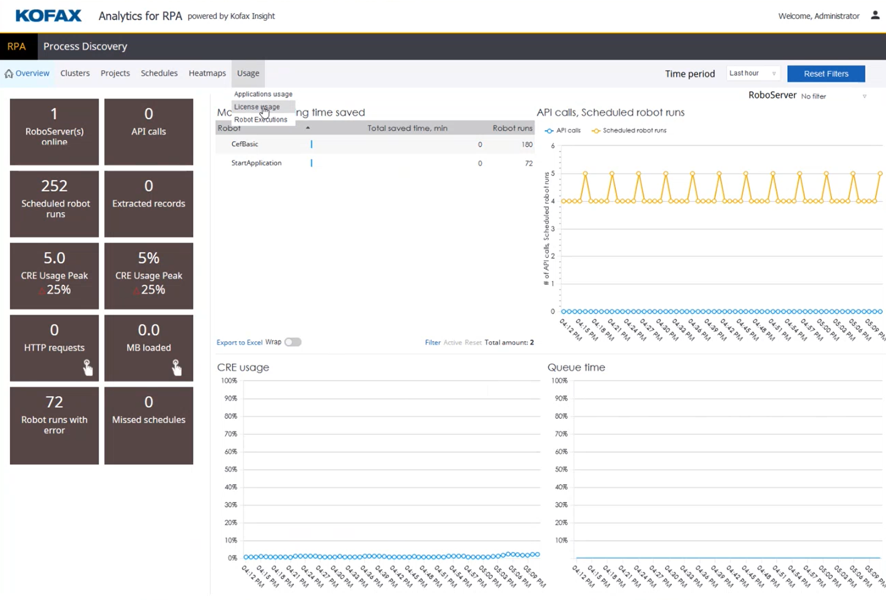
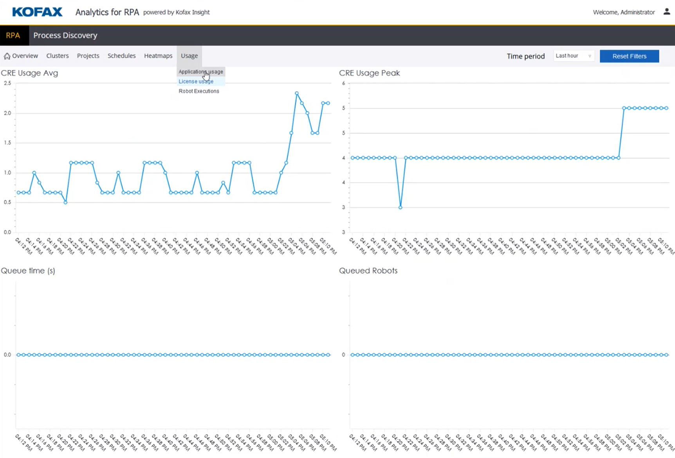
License Utilization Monitoring
What’s New in this Kofax RPA 11.2 Release
Drive down TCO and optimize license utilization by gaining transparency to application and license usage information and better plan and schedule robots throughout the day, week or month.
Powerful capabilities and transparency provided by Kofax insight’s analytics for RPA.
Advanced metrics to show relative usage.
Dig into license usage and look at full license capacity overview/utilization.
Gain highest ROI by scheduling robots to best utilize the available licenses/time.
Avoid bottlenecks and process slowdowns by optimizing robot schedules and avoid running out of licenses.
Ability to view server utilization to optimize running concurrent robots = $ savings
Shows avg. uses of CREs leading to license optimization
Transparency
Optimization
Improved TCO
Notes:
License Utilization Monitoring
Summary:
Transparency and reporting of license utilization improve TCO.
We also have robot execution usage metrics. Adding value to our customers.
This is a very important feature that helps scheduling robots, prevents running into CRE limitations and enables you as sales to know when our customers might need additional licenses.
Details:
What is the problem that exists today?
Organizations require ease of visibility and transparency to the utilization of their licenses in order to best utilize digital and human workforce. Failure to optimize leads to high costs, manual processes, and longer process TAT.
How does this capability solve the problem?
Kofax RPA provides in Kofax Analytics for RPA license capacity information in addition to the already existing license usage information to better plan and schedule the robots throughout the day, week or month. Leading to optimum utilization.
What is the Business Benefit?
Gain highest ROI by schedule robots to best utilize the available licenses
Avoid bottlenecks and process slowdowns by optimizing robot schedules and avoid running out of licenses
What features support this business benefit?
License Enhancement
License Capacity Overview

Slide 18
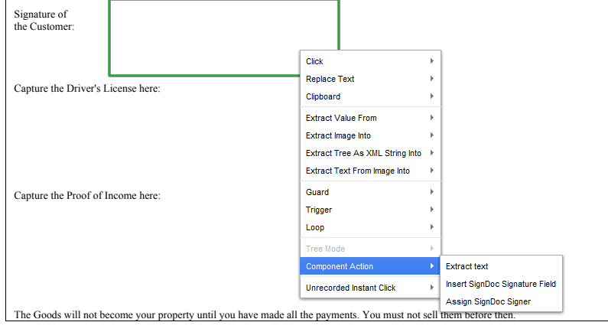
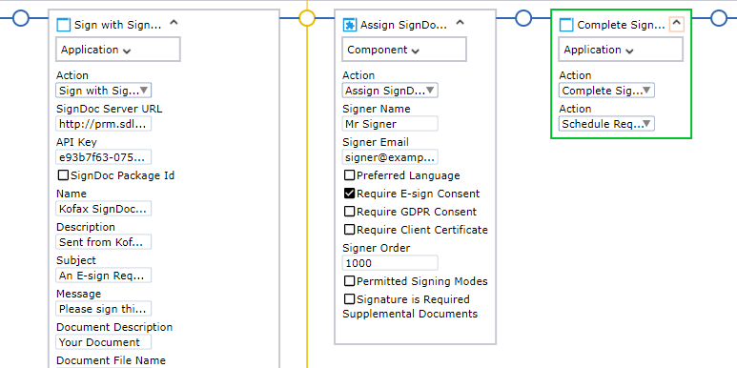
SignDoc Integration
What’s New in this Kofax RPA 11.2 Release
Kofax RPA now comes with a new eSignature step that integrates directly with Kofax SignDoc and seamlessly allows submission of documents with prefilled information for review and signing.
Easily setup and send a signing ceremony in Kofax RPA through a new step.
Continued investment in intelligent automation portfolio strategy.
Allowing filling and submission of documents for eSignature capture.
Efficiency
Ease of Use
Versatile
Notes:
SignDoc Integration
Summary:
There’s now a new advanced SignDoc Step to assign information and kick-off signing ceremonies. Supporting IA strategy.
Integration between Kofax RPA and Kofax SignDoc to easily trigger from Kofax RPA a signing ceremony.
This is critical for your customers that might already have SignDoc and are seeking to automate their signing processes without need of coding or api integrations. This is easy use from RPA.
So an opportunity for you to look at your SignDoc only customers list and sell them a few RPA licenses.
Your RPA customers also might want to embrace SignDoc.
Details:
What is the problem that exists today?
A lot of business processes today deal with documents that require a signature of one or multiple counterparts. RPA is automating tasks very well, but when it comes to capturing signatures, it often requires some manual intervention, e.g. placing a signature field to a document and assigning the right signer information.
How does this capability solve the problem?
Kofax RPA comes with a new SignDoc Step that integrates directly with Kofax SignDoc and allows to submit documents with prefilled information for review and signing. The integration eliminates the manual steps to go into Kofax SignDoc and place signature fields before sending it off.
What is the Business Benefit?
Increase the level of automation where processes with documents and signatures have to be kicked-off.
Easily setup and send a signing ceremony in Kofax RPA through a new step.
What features support this business benefit?
SignDoc Integration

Slide 19
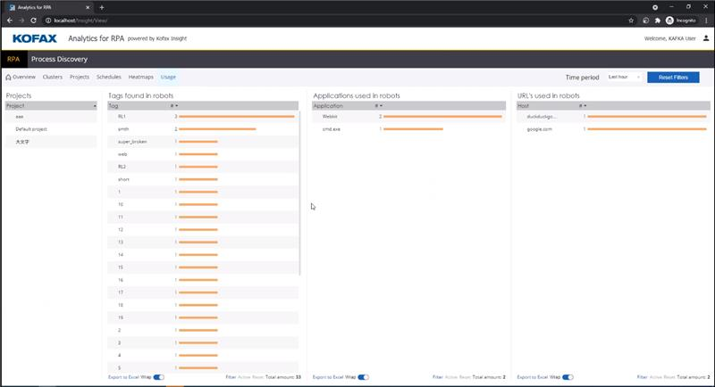
Enhanced Robot Management
What’s New in this Kofax RPA 11.2 Release
View which websites and desktop applications robots are accessing. Ease maintenance and management.
Quickly identify what robots are accessing (i.e. SharePoint, ppt, SAP, website, etc.) To support maintenance should changes occur.
Fast tracks discovery, management, and update of robots should business application changes be required.
Improved insight into automation via dashboard.
Ability to drill down to robot utilization. To get a full picture of what activities the robots are doing leading to optimization and faster maintenance.
Ease of Maintenance
Transparency
Efficiency
Notes:
Enhanced Robot Management
Summary:
Get visibility to applications and sources accessed by robots. Ease maintenance and management.
Kofax Analytics for RPA provides dashboards showing applications and websites involved in automations and the dependencies on specific enterprise applications.
Auto-Discovery capabilities pulls the information about applications and URLs accessed together for visualization.
Details:
What is the problem that exists today?
Organizations are building a large number of automations which involve multiple business applications or websites. In order to get an overview about which applications or websites have been involved, users have to maintain their own lists or skim through their robots for all the information. In case of an upgrade of business application it is challenging to quickly get an overview which automation is impacted.
How does this capability solve the problem?
Kofax RPA and Kofax Analytics for RPA provide dashboards with an overview about applications and websites used. Through auto-discovery this information is automatically pulled together and doesn’t require any manual intervention.
What is the Business Benefit?
Quickly get an overview about the dependencies of the robots and which business applications or websites are used in automations
Spend less time on searching and more quickly identify impacted business applications (e.g. when business applications get upgraded or changed)
What features support this business benefit?
Enhanced Robot Management
Robot and Step tagging (from RPA 10.7)

Slide 20
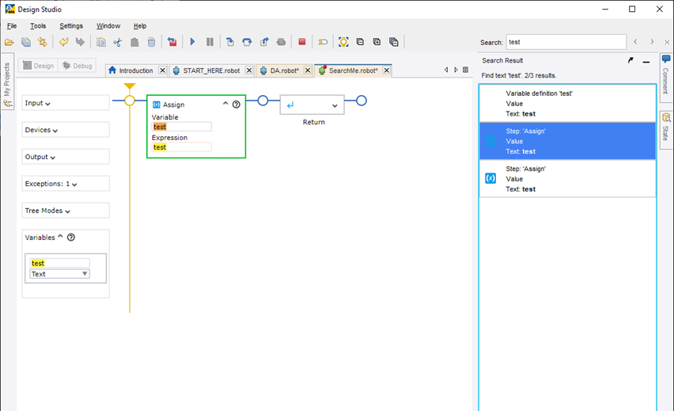
Improved Robot Building Tools
What’s New in this Kofax RPA 11.2 Release
Users building desktop automation robots can now easily search comments, variables, steps, dialogue box labels in order to quickly build, navigate, and fix large robots.
Truly powerful and simple search capability allows quicker identification of variables and highlights all occurrences by listing all results in a convenient overview within design studio.
Quicker extensive search capability within robot for faster updates, reviews, build and fixes.
Reduce efforts when building new robots based on identifying existing robots for similar processes and incorporate the changes quicker.
Speed
Efficiency
Improved Experience
Notes:
Powerful Robot Building Tools
Summary:
Users building desktop automation robots can now easily search comments, variables, steps, dialogue box labels in order to quickly build, navigate, and fix large robots.
Build, navigate, and fix large robots quicker by finding information in comments, variables, steps, dialogue box labels.
In Design Studio users building desktop automation robots can easily search in robots across variables, expressions and step names.
Details:
What is the problem that exists today?
Finding all occurrences of a variable name, expression or step name in a robot requires manual navigation through the robot. For example, changing a name of a variable in a robot that it used multiple times and missing one occurrence to change it will result in troubleshooting as the robot won’t work.
How does this capability solve the problem?
The new search capability within Design Studio for desktop automation helps to quicker find the required information and highlights all occurrences by listing all results in a convenient overview within Design Studio.
What is the Business Benefit?
Reduce robot building time by quicker find information in variables, expressions and step names
Reduce efforts when building new robots based on already existing robots for similar processes and incorporate the changes quicker
What features support this business benefit?
Search within robots

Slide 21
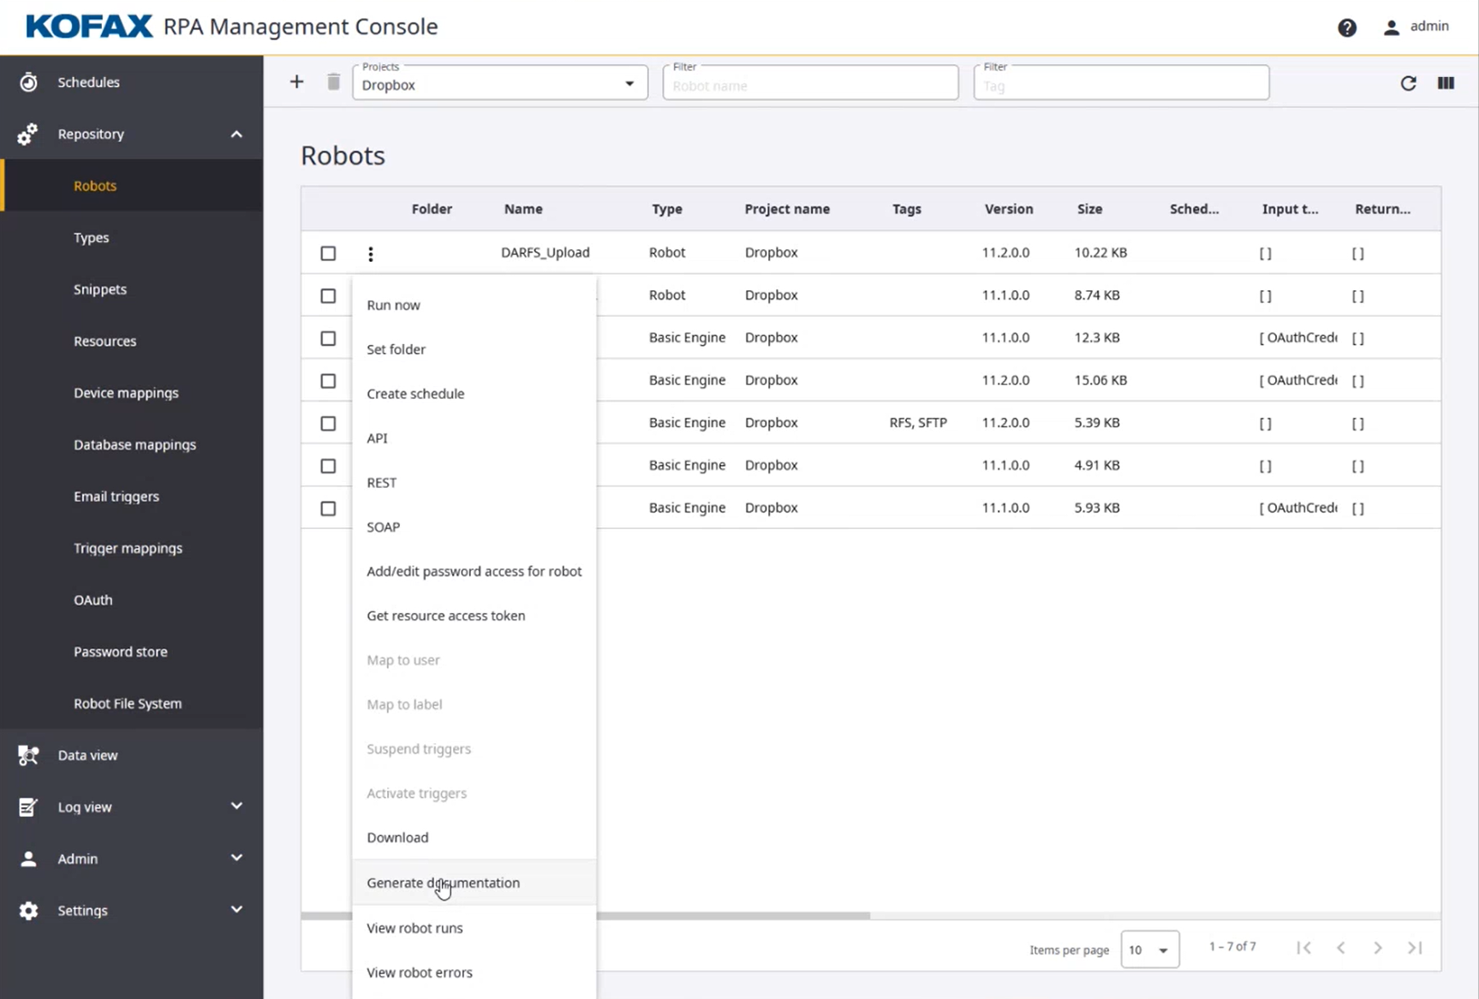
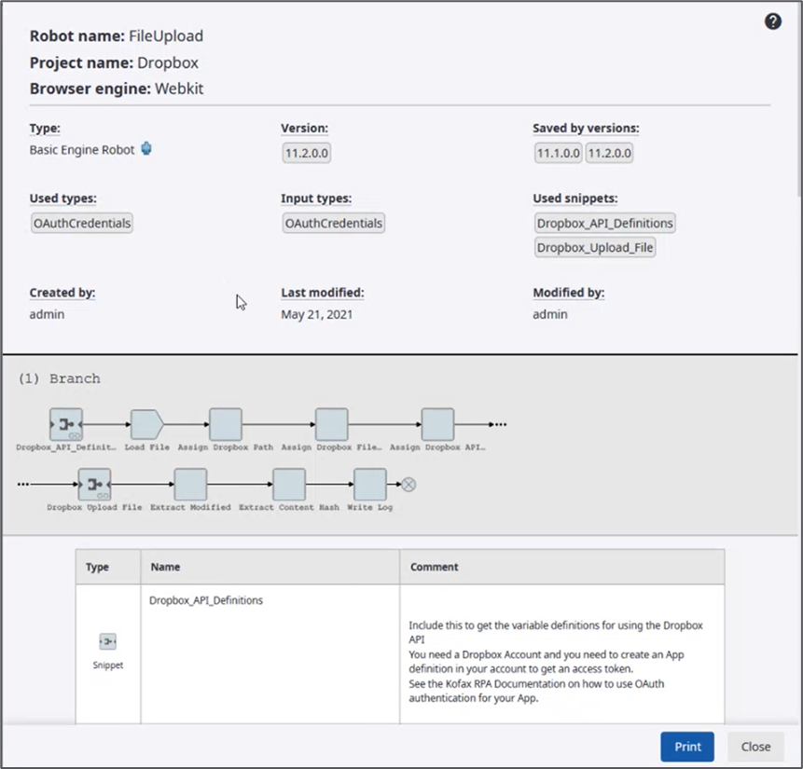
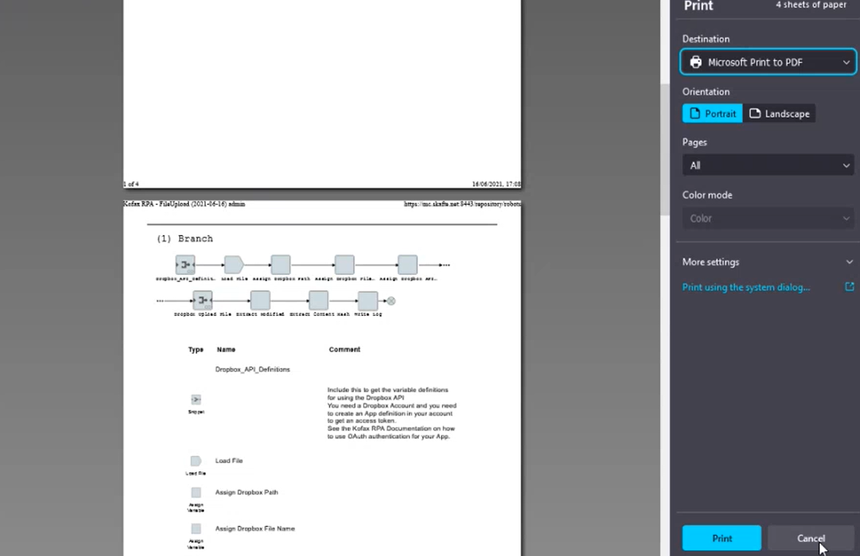

Auto-Documentation Generation
What’s New in this Kofax RPA 11.2 Release
Generate documentation with one click. Ability to provide stakeholders, such as auditors, compliance, and governance departments, documentation/SOP of robot functionality.
Kofax RPA now provides users the capability to generate robot documentation in a simple and consistent manner that provides an overview of existing robots and the detailed information about the actions that are performed.
Often a very time and labor-intensive process.
Ongoing changes and updates to the robot requiring document maintenance.
This can lead to costs as well as outdated documentation and visibility to robot’s tasks.
Documentation is required for various purposes.
Efficiency
Compliance
Knowledge Share
Notes:
Auto-Documentation Generation
Summary:
Generate automation documentation with one click. Ability to provide stakeholders, such as auditors, compliance, governance SOP, with documentation of robots and process flows.
Enables organizations to automatically generate documentation of the robot functionality with one simple click
Documentation can be exported as PDF file for audit or sharing purposes
Details:
What is the problem that exists today?
Organizations have a need to document the functionality of the robots built and the tasks they perform.
This is often very time and labor intensive, especially given ongoing changes and updates to the robot requiring document maintenance. This can lead to costs as well as outdated documentation and visibility to robot’s tasks.
The documentation is required for various purposes such as sharing the knowledge about the available robots (e.g. for a new robot developer), compliance, governance and auditing efforts purposes.
How does this capability solve the problem?
Kofax RPA provides users the capability to generate robot documentation in a simple and consistent manner that provides an overview of existing robots and the detailed information about the actions that are performed.
What is the Business Benefit?
Eliminates the manual, labor intensive, costly effort in creating documentation for every robot and process.
Helps to fulfill compliance, governance, and continuous improvement requirement.
What features support this business benefit?
Automated Documentation Generation
Robot Tagging (from RPA 10.7)
Robot and Step Commenting (from RPA 10.7 expanded)

Slide 22

And Much More…
What’s New in this Kofax RPA 11.2 Release
Release Notes
Fuzzy image finder (match accuracy parameters)
Additional headless excel component actions (convert range to table, search capabilities)
Mail step – open mailbox (get email, delete email, move email)
Get UI automation tree of MS Edge, Firefox, Chrome (see automation native tree)
CEF create page step (create HTML custom page and open as a webpage)
CEF open link in new window (easily open a new window)
Finder match text including descendants support
Execute JavaScript in IE (inject JS into IE browser)
Device Mappings as parameters
Pass a dynamic mapping to a robot with static device to reuse connections
Support for scheduling of Kapplets
Users can create schedules
Schedules from legacy Kapplets backups can be restored
Improved access management
Users can only see robots in projects they have access to
Queuing supported for Robots executed via management API
Kapplets use queue for executing
DTS Callback uses queue
Improved Audit Logging
Continuing to improve the experience by delivering higher quality releases:
166 incoming customer bugs reported during the project
180 fixed
29 field request delivered

Slide 23

DEMO

Slide 24
Kofax RPA – 11 Key Differentiators
How we Differentiate
1
Interactive visual no code designer
6
Automation Sharing
2
Scalable RPA Architecture - Robot Built-In Skills
7
Robot Connector Framework with Robust Ecosystem
3
Embedded AI & Cognitive Capture for unstructured data
8
API Integration including Robot APIs
4
Intelligent Screen Automation
9
Deployment Choice – On Premise and Cloud
5
Centralized Robot Execution & unique server architecture
10
Powerful Enterprise license model
Notes:
What I’ve done here is to bring 11 key differentiators that are key for us to keep in mind while we talk about our 20+ year history with RPA
Powerful interactive, no code visual designer. If you look at many other products out in the market, you will notice that most have and require a very strong coding element. Understanding classes and sub-classes in how to build and connect an actual robot. Ours is very visual and interactive enabling you to build and run your robots in parallel and test them. We continue to get great accolades from large scale organizations and development shops that find great value in the design of our product. We are very focused on server-side unattended enterprise RPA and that’s where we have invested and where we continue to scale RPA.
Robot built-in skills. we have built in skills in robots that do not require a desktop. This is about efficiency and no reliance on virtual desktops. You do not need a browser or an environment to run a browser on a desktop to have your robots operate. You’ll often hear the word head-less which really requires no virtual desktop to run a number of tasks and those features are just built in. This drives speed and minimizes cost. This is extremely powerful.
Embedded AI and capture. Based on looking at various vendors, we believe there is not one RPA vendor that matches our AI and capture skillset. Another extremely powerful solution, especially when you consider most tasks require and input and those inputs are often structured or unstructured data to work with.
Our Intelligent Screen Automation in our RPA solutions uses our own engine which is OmniPage. So, in our case, instead of utilizing a public/free engine that many of the RPA vendors typically use, we have our own that is very powerful differentiator and we invest to make the OCR even better, especially when you have to fall back to screen automation in legacy or certain situation that really makes a difference. In times when you need screen capture from a legacy citric environment for instance, you are going to need tools to help you solve for that step.
Centralized Robot Execution & unique server architecture – this is one of those things that is often very underestimated by customers shopping for RPA solutions. And often quickly passed over by vendors. As you look to deploy robots into a large environment, thinking of how to scale and run them, mange them is critical. Our robot manager with ability to create clusters, creating unique groups is a powerful feature and is included in our product for no extra cost or license. This really speaks to how our solution overall is priced and capabilities included that are otherwise sold separately by other vendors.
Automation sharing via caplets. I am always amazed at the stories I hear around organizations using non-Kofax solutions with their robots who build a little team of one developer, who create a library of robots for a particular community call it a “call center” that do 5 or 6 things. They build the websites and forms to collect data to hand to robots, they build forms and data containers to bring the data back from the robot and on top of it build and maintain a website to show the performance and analytics in their call center. And that group of people have to do that and maintain. With our solution, non of that is required. All of that is built in. With kapplets, you literally just say I want these robots, these are the forms and inputs, forms and data collection is auto generated, the results are brought in and available on a Mobile device or a desktop. And we allow you to easily share those robots in large communities. With little to no coding required. Again, all are parts of our product included. And when you think about how to scale, you normally go to these communities to use and expand. It is about sharing robots and automation with a greater audience.
Robot connector framework – for developers who let’s say build complex integrations for logging into a system, etc. using code, they often want to share this with others like RPA developers for reuse and efficiency. And this is where the robot connecter framework comes in to enable this sharing of efforts.
API integration – our product has a really awesome feature. It is called synthetic APIs and what that means is generating an API automatically, for a robot. So a CD builds a robot, it collects bits of information and you'd like to connect it to another environment. You get an automatic API for that robot that enables ease of adaptability to others using Rest and Soap for example.
Deployment choice – on-prem and support for cloud deployments with docker to allow you to deploy as you choose.
License model. As we did a lot of research on market and competitors, we identified that we offer a lot with our license with our concurrent robot license. We include in that license pages of structured and unstructured data and AI with it, we include our process discovery, we include the #5 (centralized robot execution) for no extra cost. We do not require virtual desktop. At the end, when you look at what we offer in our license, you see a robust feature rich solution for truly utilizing and scaling. Minimizing expenses as you utilize the solution. Our large clients always appreciate this for their enterprise solution.
There are no hidden fees: Unlimited non-prod robots, management console for free (UiPath control tower), product discovery, you get a scalable product.
Scalability = 4 out of 5 initiatives never go beyond 5 robots. To scale beyond those 5, you need a scalable platform. You want to be able to go above POC.
Customers: “You are so much easier to work with”
Rabobank, ABN Amro, MUFG, Duke Energy.

Slide 25
Intelligent Automation Platform
How we Differentiate
11
Notes:
#11 is my favorite and one that is a major differentiation for scaling beyond RPA and where the market is going and where we are heavily investing – our IA platform.
Certainly this is one of our more powerful differentiators and often where clients appreciate the power of Kofax to truly drive digital workflow transformation and not just solve for happy paths.
You’ll notice task automation and workflows in this arch incorporating RPA in a broader set of low code capabilities.
This powerful platform reduces the need for several software, tools, vendors, pricing and contract talks, lengthy integrations and maintenance efforts.
We believe that RPA being part of IA and ML makes smarter and more robust robots and drives more workflow automation and ROI.
These 3 categories embedded within our IA platform (Document Intelligence, Connected Systems, and Process Orchestration), bring enormous value and are critical to our customer’s success.

Slide 26
Market-Leading Differentiated RPA Platform
Integrated platform technologies required to derive value
Process Discovery, AI / ML, BPM, Analytics, Cognitive Capture
Industry’s most advanced embedded AI/ML & Cognitive Document Automation
RPA Patents for Classification, Data Collection, and Webpage Processing
Kofax RPA scales more cost-effectively and doesn’t require a VDI for every robot
Docker containerization to support Cloud choice

Slide 27

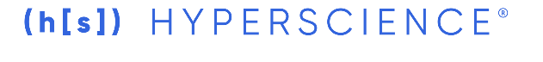








Market Dynamics Drives New Opportunities
Competitive Landscape
Capture & AI
DPA
Low Code
RPA
Intelligent Automation
DPA: Digital Process Automation
Notes:
Let’s turn quickly to the market dynamics.
<Click>
I think it’s important for everyone to understand the dynamics that are going on in the market and how that plays into our strategy of competing and winning.
We start off in the market that was Capture and AI, the Googles, Abbyy’s, Microsoft, etc. that have entered into this space and are providing this part of the solution.
Then we enter RPA and we see a saturated space with many new players entering. Microsoft has entered into this space. Hyland and others.
Then on the end we have DPA platforms. Think of it as BPM, and entering into low code space. An emergence of Pegga, Appian, etc. And they are starting to acquire RPA companies and entering into the RPA space as well.
So as we take a look holistically, we see this convergence and this sweat sopt that drives true value for customers. Be it Document Intelligence, Process Orchestration, or Connecting Systems.
<Click>
IA is a spot where Kofax has been investing for several years and have a strong footing in. We already spoke about the power of IA.
So I want to remind you to keep this in mind as we think about how we approach the competition and how we win. How we create value for our customers.
So leveraging the IA platform in your conversations is absolutely critical to win. Kofax’ IA portfolio enables scale beyond RPA for clients in their DWT journey.
Convergence of the market to Intelligent Automation.
RPA/DPA/Capture market coming together – creates winners and losers
DPA focused analysis…but you’ll see inputs related to Capture/RPA
“New” space created
Convergence has traditional competitors…but also newer ones: MSFT, Google, AMZN Sagemaker

Slide 28





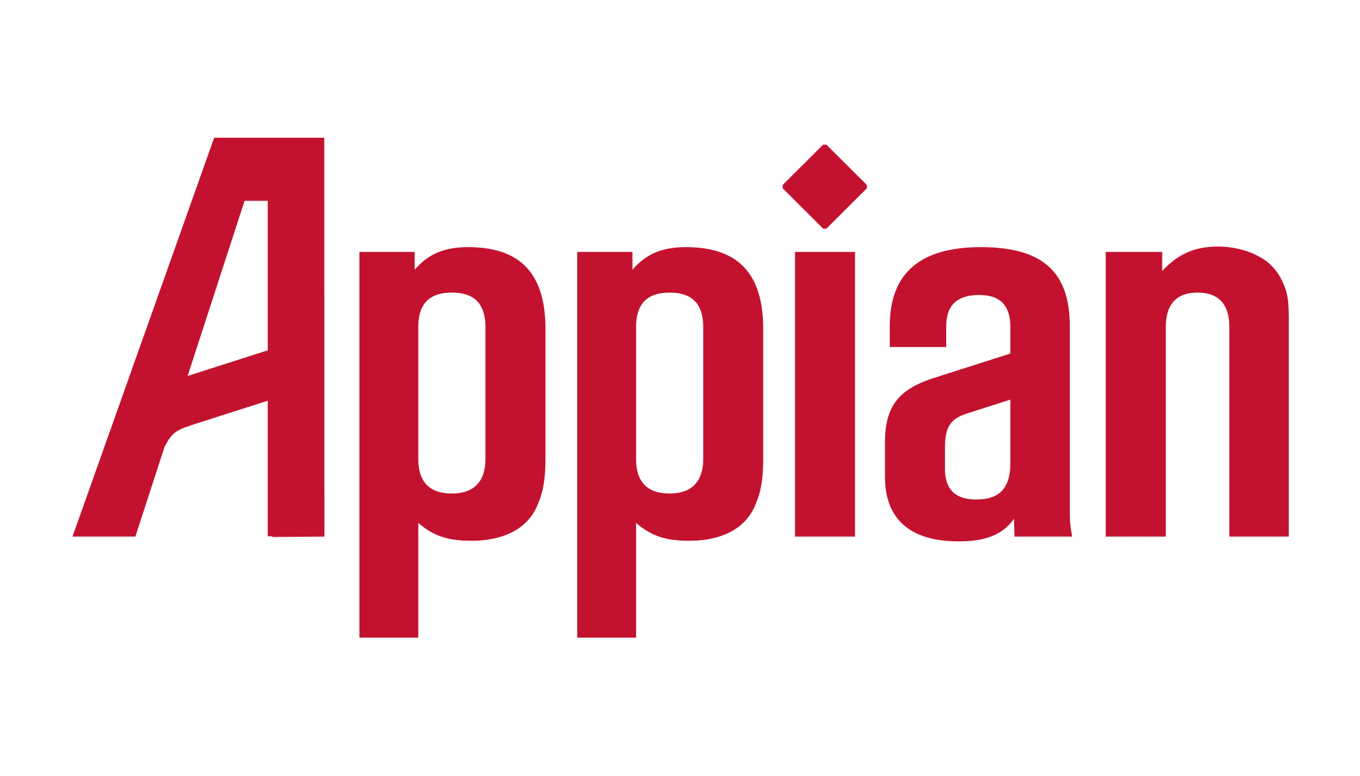



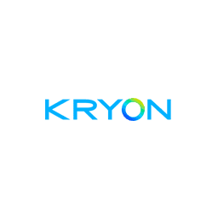
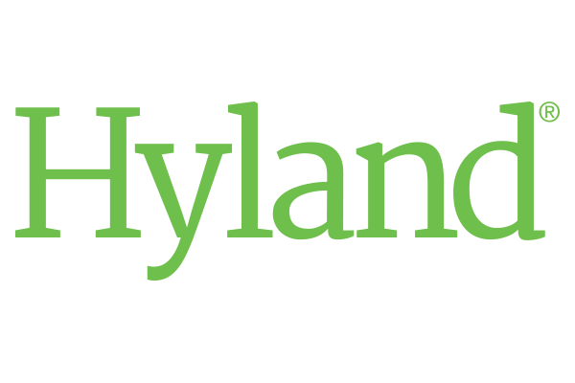




How We Win!
Competitive Landscape
RPA Focused
DPA/Workflow
Our “Competition”
Powerful RPA Product for Enterprise automation
Powerful human in the loop capabilities for process orchestration
Embedded Document intelligence with industry leading cognitive capture and artificial intelligence
One unified platform that enables true Digital Workflow Automation from one single vendor
Kofax Unified Solution
28
Notes:
As I mentioned at the start of this session, our customers LOVE Kofax RPA. From a TCO and features, it delivers what customers expect to automate mundane tasks.
You should feel VERY comfortable talking about and selling Kofax RPA and with this release we have enhanced our solution further.
1. So we have a powerful solution. We talked about those 11 differentiators.
2. Higher value solutions require more than that and that’s where process orchestration, document intelligence and our unified platform really come in and help us win.

Slide 29
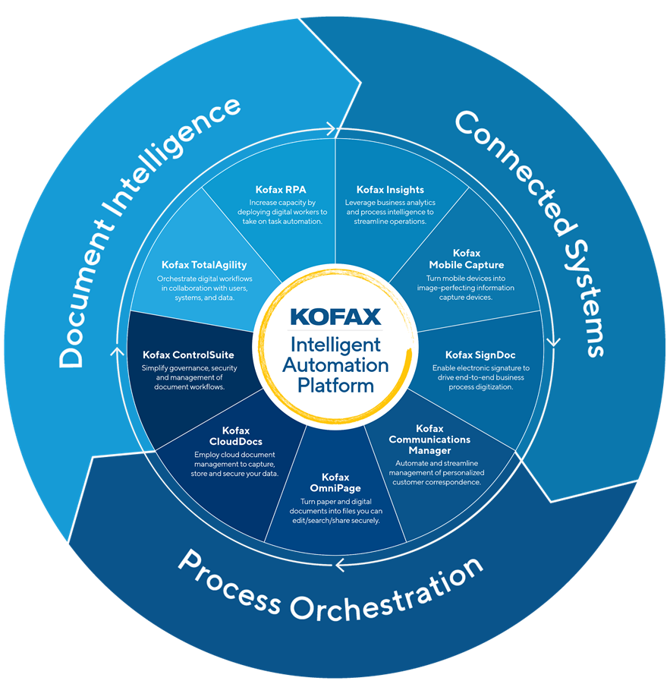
How Will This Release Help Me Sell More?
1
Summary and Q&A
Gain momentum in your existing accounts
Enable your customers to invest, expand and do more
Talk to your existing clients who might not have Kofax RPA:
Kofax SignDoc – integration between RPA and SignDoc
Kofax Capture
Kofax ControlSuite
AP Agility
Readsoft Online
Kofax TotalAgility
Notes:
RPA is a great solution to add to your existing deals. IF your customers are already working with exciting capabilities from Kofax, or brought in to look at workflow automation using some of our other products, you want to use the opportunity to discuss RPA and KTA solution.
RPA investments will continue in line with our IA Strategy = AI, Cloud, CX, Platform Integration, Low-code.
Tighter RPA integration with the TotalAgility platform
A more focused and agile Kofax business built for speed and customer satisfaction…which is critical since >30% of 2021 new bookings-to-date are recurring Subscription / SaaS licensing
Current RPA customers and pipeline deals should not feel anything but more attention and support as we optimize customer journey touchpoints via our Customer Experience Program

Slide 30
Digital Workflow Transformation & RPA Success
2
Summary and Q&A
Understand the broader workflow beyond just RPA
Identify and create value around Kofax DNA
Document Intelligence
Process Orchestration
Connected Systems
Highlight “RPA Only” Weakness
Position the IA Platform to Win
Notes:
As we look to win in the market we all recognize that RPA has a lower probability of winning the DWT effort vs. when we bring in our platform with these 6 capabilities in this arc.

Slide 31
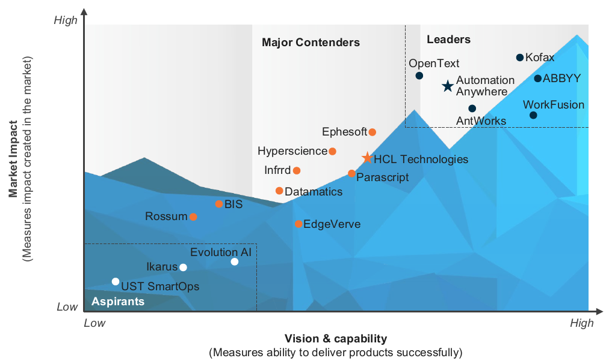
Global Analysts have embraced the Intelligent Automation platform and positioned Kofax as a Hyper Intelligent Automation leader
Everest ranks Kofax a Leader in Intelligent Document Processing
Zinnov ranks Kofax a Leader in Hyper Intelligent Automation
Source: Everest 2020 Intelligent Document Processing Peak Matrix
Source: Zinnov 2021 Hyper-Intelligent Automation Zone

Slide 32






Release Resources
Summary and Q&A
Release Highlights
Release Documentation
Release Notes
GitHub Get Started
Free Trial
RPA 11.2
Learn key benefits of RPA 11.2 release and additional services to help create value for your customers.
Learn about the new features and enhancements in Kofax RPA 11.2 and review current system requirements.
Access technical product documentation of RPA 11.2 release. Learn system requirements, product documentation and more.
Access new Kofax RPA 11.2 release and prior releases. Interact with the community.
Get started with the most scalable robotic process automation platform in the market. Or, download RPA 11.2 from delivery.Kofax.com

Slide 33

Q&A - Call to action
Engage with us
Go sell
Share your stories

Slide 35
Reference Session Recording
Sales/Partner Enablement:
How to find
How to Subscribe for notifications
Technical Enablement:
Richard to-do

Slide 36



Concurrent Execution Mode
What’s New in this Kofax RPA 11.2 Release
Edit multiple robots concurrently in the designer. In Desktop Automation run robots in parallel in debug mode while editing other robots in Design Mode.
Users creating robots have the need to run a certain Desktop Automation robot in Debug mode, but also edit at the same time other robots in Design mode.
Users can work more efficiently in parallel on robots.
Debug mode doesn’t have to be stopped before working on a robot in Design Mode.
Efficiency
Ease of Use
Speed
Notes:
Concurrent Execution Mode
Summary:
Edit multiple robots concurrently. Run robots in debug mode while editing robots in Design Mode.
In Desktop Automation run robots in parallel in debug mode while editing other robots in Design Mode.
Details:
What is the problem that exists today?
Users creating robots have the need to run a certain Desktop Automation robot in Debug mode, but also edit at the same time other robots in Design mode.
How does this capability solve the problem?
In RPA 11.2, Desktop Automation has been enhanced that users can work at the same time on a robot in Design mode while running a robot in Debug mode.
What is the Business Benefit?
Users can work more efficiently in parallel on robots
Debug mode doesn’t have to be stopped before working on a robot in Design Mode
What features support this business benefit?
Multiple Execution Mode

Slide 37
Beyond RPA’s Task Automation
Artificial
Intelligence
Intelligent
Automation
Mimics human actions and decision-making using advanced technologies to understand environments and improve outcomes while creating the AI Digital Worker
Robotic Process
Automation
Value
Scripts / Macros
Augments human judgment and decision making by combining machine learning and automation to create smart Digital Workers
Automates rules-based tasks across multiple applications to create a Digital Worker
Automates rules-based tasks within a single application
Automation Capability

Slide 38
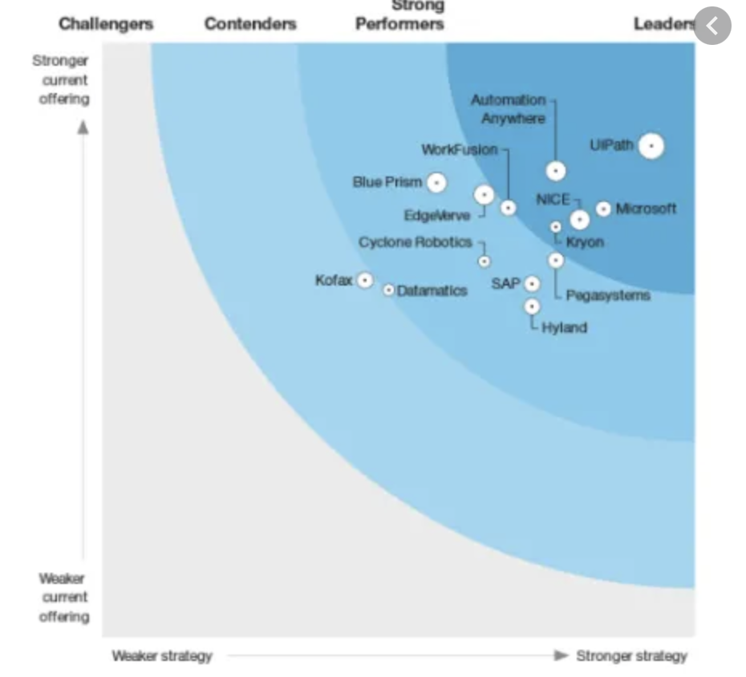
Strategy Focus on Digital Workflow Transformation
RPA-Only
RPA as a component of IA Platform
‘RPA-only = Automation Scalability Challenges’ and IS Not where we win
RPA-only = stuck in POC-land = resource drain on our business
Highly competitive market with Poor unit economics
Incremental value to customers
‘RPA+BPM+Capture = Automation @ Scale’ and IS where we win
IA Platform = transformational value = higher ASP, greater customer LTV and company growth / profitability
Not overly competitive market with favorable unit economics
Impactful value to customers
Zinnov
Platform
Forrester
RPA Only
+40 non-listed vendors
38
Notes:
Our strategy has always been consistent from the beginning about RPA as a component of our IA platform as you saw a few slides ago. Task automation and RPA is part of several capabilities that will help drive DWT.
RPA by itself has some challenges when it comes to the type of data it needs and types of tasks that can get automated.
Also as we looked at, it’s a highly competitive and saturated market with players such as MS giving away RPA for windows customers.
Also, when you look at analysts that solely look at RPA centric organizations, we will not be doing well on those reports.
Our focus has been on how do you leverage RPA in the right place and the right time to solve greater higher value solutions. And that’s where we are focused, and you see analysis such as Zinnov who are looking at this holistic DWT solution with right tools and capabilities ranking us high on our ever-evolving platform.

Slide 39






RPA
Competitive Landscape
Power Automate

Slide 40


Capture & AI
Competitive Landscape
“Traditional” Capture
“New Breed” AI

Slide 41

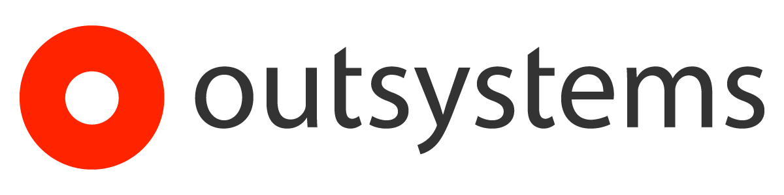

Digital Process Automation
Competitive Landscape

